Slide 1


Topic – 7: Uncertainty
Department of Computer Science and Engineering
Daffodil International University

Slide 2

Topic Contents
Acting under Uncertainty
Basic Probability Notation
The Axioms of Probability
Inference Using Full Joint Distributions
Independence
Bayes’ Rule and Its Use

Slide 3
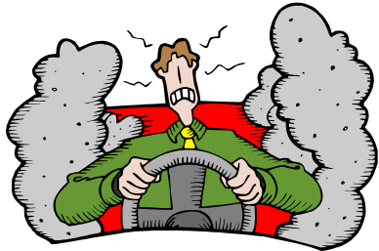

Autonomous Agents
Real World
Driving Agent
Sensors
camera
tachometer
engine status
temperature
Model of
vehicle location & status
road status
Prior Knowledge
physics of movement
rules of road
Reasoning &
Decisions Making
Effectors
accelerator
brakes
steering
Actions
change speed
change steering
Goals
drive home
Notes:
CLICK SLIDE

Slide 4
Uncertainty in the World Model
The agent can never be completely certain about the state of the external world since there is ambiguity and uncertainty.
Why?
  sensors have limited precision
    e.g. camera has only so many pixels to capture an image
  sensors have limited accuracy
    e.g. tachometer’s estimate of velocity is approximate
  there are hidden variables that sensors can’t “see”
    e.g. vehicle behind large truck or storm clouds approaching
  the future is unknown, uncertain,
  i.e. cannot foresee all possible future events which may happen
Notes:
CLICK EACH SUB

Slide 5
Rules and Uncertainty
Say we have a rule:
if toothache then problem is cavity
But not all patients have toothaches due to cavities
so we could set up rules like:
if toothache and not(gum disease) and not(filling) and ...
then problem = cavity
This gets complicated, a better method would be:
if toothache then problem is cavity with 0.8 probability
or P(cavity|toothache) = 0.8
the probability of cavity is 0.8 given toothache is all that is known
Notes:
CLICK EACH SUB

Slide 6
Uncertainty in the World Model
True uncertainty: rules are probabilistic in nature
  rolling dice, flipping a coin?
Laziness: too hard to determine exceptionless rules
  takes too much work to determine all of the relevant factors
  too hard to use the enormous rules that result
Theoretical ignorance: don't know all the rules
  problem domain has no complete theory (medical diagnosis)
Practical ignorance: do know all the rules BUT
  haven't collected all relevant information for a particular case
Notes:
CLICK EACH

Slide 7
Logics
Logics are characterized by
what they commit to as "primitives".
Logic | What Exists in World | Knowledge States
Propositional | facts | true/false/unknown
First-Order | facts, objects, relations | true/false/unknown
Temporal | facts, objects, relations, times | true/false/unknown
Probability Theory | facts | degree of belief 0..1
Fuzzy | degree of truth | degree of belief 0..1
Notes:
CLICK EACH SUB

Slide 8
Probability Theory
Probability theory serves as a formal means
  for representing and reasoning
  with uncertain knowledge
  of manipulating degrees of belief
  in a proposition (event, conclusion, diagnosis, etc.)
Notes:
CLICK EACH SUB

Slide 9
Utility Theory
Every state has a degree of usefulness or utility and the agent will prefer states with higher utility.

Slide 10
Decision Theory
An agent is rational if and only if it chooses the action that yields the highest expected utility, averaged over all the possible outcomes of the action.
Decision theory = probability theory + utility theory

Slide 11
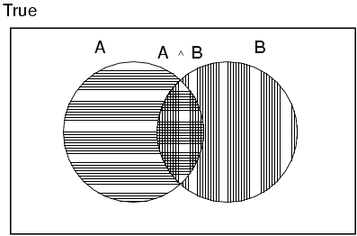
Kolmogorov's Axioms of Probability
0 ≤ P(a) ≤ 1
  probabilities are between 0 and 1 inclusive
P(true) = 1, P(false) = 0
  probability of 1 for propositions believed to be absolutely true
  probability of 0 for propositions believed to be absolutely false
P(a ∨ b) = P(a) + P(b) - P(a ∧ b)
  probability of two states is their sum minus their “intersection”
Notes:
CLICK EACH SUB

Slide 12

Inference Using Full Joint Distribution
Start with the joint probability distribution:

Slide 13

Inference by Enumeration
Start with a full joint probability distribution for the Toothache, Cavity, Catch world:
P(toothache) = 0.108 + 0.012 + 0.016 + 0.064 = 0.2

Slide 14

Inference by Enumeration
Start with the joint probability distribution:
Can also compute conditional probabilities:
P(¬cavity | toothache) = P(¬cavity ∧ toothache)
P(toothache)
= 0.016+0.064
0.108 + 0.012 + 0.016 + 0.064
= 0.4

Slide 15
Independence
Independence between propositions a and b can be written as:
P(a | b) = P(a) or P(b | a) = P(b) or P(a ∧ b) = P(a) P(b)
Independence assertions are usually based on knowledge of the domain.
As we have seen, they can dramatically reduce the amount of information necessary to specify the full joint distribution.
If the complete set of variables can be divided into independent subsets, then the full joint can be factored into separate joint distributions on those subsets.
For example, the joint distribution on the outcome of n independent coin flips, P(C₁, . . . , C_{n}), can be represented as the product of n single-variable distributions P(C_{i}).

Slide 16
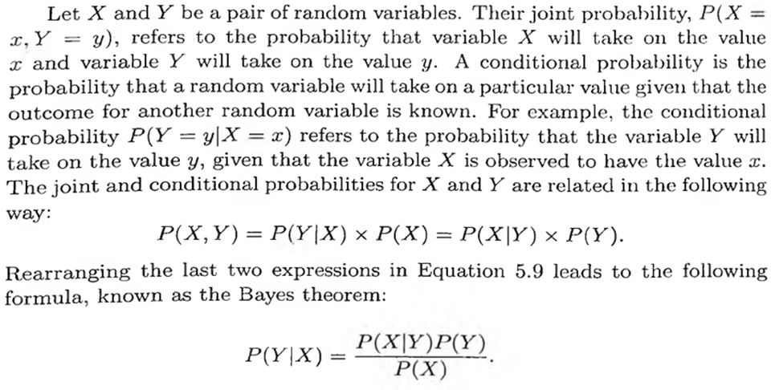
Bayes’ Theorem

Slide 17
Bayes’ Theorem
P(A∧B) = P(A|B)P(B)
P(B∧A) = P(B|A)P(A)
P(B|A)P(A) = P(A|B)P(B)
P(B|A) = P(A|B)P(B)
P(A)
Bayes’ law (also Bayes’ law or Bayes’ rule) is fundamental to probabilistic reasoning in AI!!

Slide 18
Bayes’ in Action
Bayes’ rule requires three terms - a conditional probability and two unconditional probabilities - just to compute one conditional probability.
Bayes’ rule is useful in practice because there are many cases where we do have good probability estimates for these three numbers and need to compute the fourth.
In a task such as medical diagnosis, we often have conditional probabilities on causal relationships and want to derive a diagnosis.

Slide 19


Bayes’ in Action
Example:
A doctor knows that the disease meningitis causes the patient to have a stiff neck, say, 50% of the time. The doctor also knows some unconditional facts: the prior probability that a patient has meningitis is 1/50,000, and the prior probability that any patient has a stiff neck is 1/20. Let s be the proposition that the patient has a stiff neck and m be the proposition that the patient has meningitis.
Solution:
This question can be answered by using the well-known Bayes’ theorem.

Slide 20

Bayes’ in Action
Solution:
P(s|m) = 0.5
P(m) = 1/50000
P(s) = 1/20

Slide 21
Bayes’ Theorem
Example
Consider a football game between two rival teams: Team 0 and Team 1. Suppose Team 0 wins 65% of the time and Team 1 wins the remaining matches. Among the games won by Team 0, only 30% of them come from playing on Team 1 ’s football field. On the other hand, 75% of the victories for Team 1 are obtained while playing at home. If Team 1 is to host the next match between the two teams, which team will most likely emerge as the winner?
Solution:
This question can be answered by using the well-known Bayes’ theorem.

Slide 22
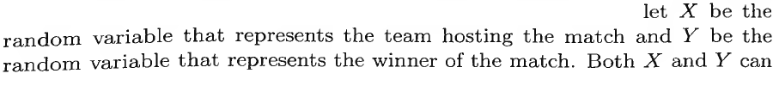
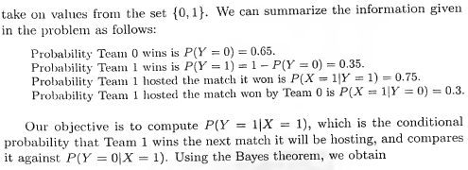
Bayes’ Theorem

Slide 23
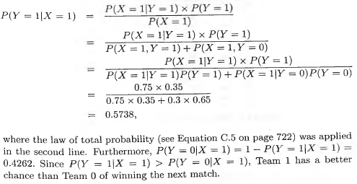
Bayes’ Theorem

Slide 24
Using Bayes’ Theorem More Realistically
Bayes’ian updating
  P(Cavity | Toothache ∧ Catch) = P(Toothache ∧ Catch | Cavity) P(Cavity)
Notes:
⇒¬∨∧∀

Slide 25

THANKS…

